Slide 1

Getting up to speed with JS
Integrating with FileMaker 19 & Carafe.FM & myMateJSON
dotFMP, Berlin 2020
mrwatson-gbs

Slide 2

😴

Slide 3
Getting up to speed with JS
FileMaker 19 Web-Integrations with Carafe.FM, JSON & myMateJSON

Slide 4
What are good milestones on the road to becoming a JavaScript master and how much time would it take?
First Milestone - Recognise the need to know
Second Milestone - Understanding the basics.
Third milestone - Production code.
Fourth milestone - Teaching.
Fifth milestone - Time.
https://www.quora.com/What-are-food-milestones-on-the-road-to-becoming-a-JavaScript-master-and-how-much-time-would-it-take

Slide 5
WARNING
This is NOT a MASTER-CLASS
It is at most a MISTER-CLASS

Slide 6
Getting up to speed with JS
FileMaker 19 Web-Integrations with Carafe.FM, JSON & myMateJSON

Slide 7
Part I
FileMaker 19 Web-Integrations
with Carafe.FM, JSON & myMateJSON
Getting up to speed with JS

Slide 8
FM19 Web-Integration Technologies

Slide 9
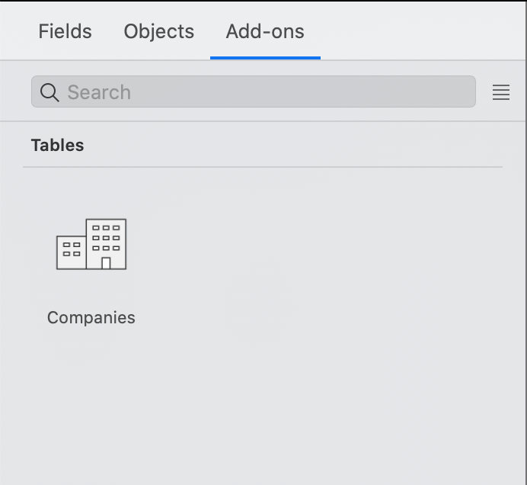
AddOns
One Click Wonders !
Great things coming very soon
But not today…

Slide 10


WebViewer Integraton

Slide 11
WebViewer Integraton

Slide 12

WebViewer Integraton
FileMaker Script Step
  Perform JavaScript in Web Viewer
JavaScript function
  FileMaker.PerformScript

Slide 13
WebViewer Demo

Slide 14
WHY get up to speed with JS?

Slide 15

FileMaker 18
The FileMaker fishbowl
Cosy in here!

Slide 16
FileMaker 19
Rest
codewars
object-oriented
programming
functional programming
filter
===
vizhub
Object
inheritance
map
reduce
=>
short circuit
boolean operators
tableau
setTimeout
jsfiddle
Carafe.FM
freecodecamp
CDN
jsdiff
$(…)
data:text/html,
Widget-Studio
codepen
open
platform
markup
HTML5
http
AJAX
let
&&
Mozilla
IIFE (Immediately Invoked Function Expression
svg.selectAll
widget
mermaid-js
API-Key
HTML
moment
jsdelivr
data api
NULL
mime-types
JavaScript
build
scripts
prototype
JSON
ECMAScript
myMateJSON
<script>
API
json-schema
SVG
jQuery
CommonJS
svelte
gulp
google
maps
diff
SVG
paths
ES6
bundle.js
grunt
DOM
d3
yarn
code .
VS-Code
module
jslint
Mike
Bostock
CSS
--variables
yaml
flexbox
css
linter
visualisation
observable.hq
npm
vega-lite
grid
branch
c3
responsive
design
bubble event
behaviour
CSS preprocessor
this
i++
git
node.js
package.js
Sankey
depends
less
SASS
data
binding
web pack
License
push to origin
MIT
open-source
pull
request
npx
Creative
Commons
function
method
chaining
terminal
dependency
hell
GitHub
.gitignore
babel
chmod
GNU
selection.join
cd
markdown
repo
transpiler
literal
syntax
Array.slice
fork
zsh
Copyleft
tiny MCE
Quill

Slide 17
FileMaker 19
Rest
codewars
object-oriented
programming
functional programming
filter
===
vizhub
Object
inheritance
map
reduce
=>
short circuit
boolean operators
tableau
setTimeout
jsfiddle
Carafe.FM
freecodecamp
CDN
jsdiff
$(…)
data:text/html,
Widget-Studio
codepen
open
platform
markup
HTML5
http
AJAX
let
&&
Mozilla
IIFE (Immediately Invoked Function Expression
svg.selectAll
widget
mermaid-js
API-Key
HTML
moment
jsdelivr
data api
NULL
mime-types
JavaScript
build
scripts
prototype
JSON
ECMAScript
myMateJSON
<script>
API
json-schema
SVG
jQuery
CommonJS
svelte
gulp
google
maps
diff
SVG
paths
ES6
bundle.js
grunt
DOM
d3
yarn
code .
VS-Code
module
jslint
Mike
Bostock
CSS
--variables
yaml
flexbox
css
linter
visualisation
observable.hq
npm
vega-lite
grid
branch
c3
responsive
design
bubble event
behaviour
CSS preprocessor
this
i++
git
node.js
package.js
Sankey
depends
less
SASS
data
binding
web pack
License
push to origin
MIT
open-source
pull
request
npx
Creative
Commons
function
method
chaining
terminal
dependency
hell
GitHub
.gitignore
babel
chmod
GNU
selection.join
cd
markdown
repo
transpiler
literal
syntax
Array.slice
fork
zsh
Copyleft
tiny MCE
Quill

Slide 18
How to bring two different worlds together?
FileMaker
Development
Web
Development

Slide 19
How to bring two different worlds together?
FileMaker
Development
Web
Development

Slide 20
Five Levels of Integration / Skills / Tools
1. FileMaker Add Ons = Click+Play / FileMaker 19
2. 'Widgets' = … + JSON / Widget Studio / Carafe.FM / CDNs
3. Tinkerer = … + Basic HTML, CSS, JS, SVG
4. JavaScript / Visualizer = … + JavaScript / d3 / c3 / other libraries
5. Web-Developer = … + VS-Code, automation tools (grunt, gulp), node, npm, git[hub], markdown, react, … etc., etc., etc.

Slide 21

Carafe.FM
(Carafe Kitchen)

Slide 22
Carafe Demo

Slide 23
How to bring two different worlds together?
FileMaker
Development
Web
Development

Slide 24
How to bring two different worlds together?
FileMaker
Development
Web
Development

Slide 25

myMateJSON
Helps you get your JSON straight!
Home: https://www.fmworkmate.com/mymatejson
Repo: https://github.com/mrwatson-de/myMateJSON

Slide 26
myMateJSON Demo

Slide 27
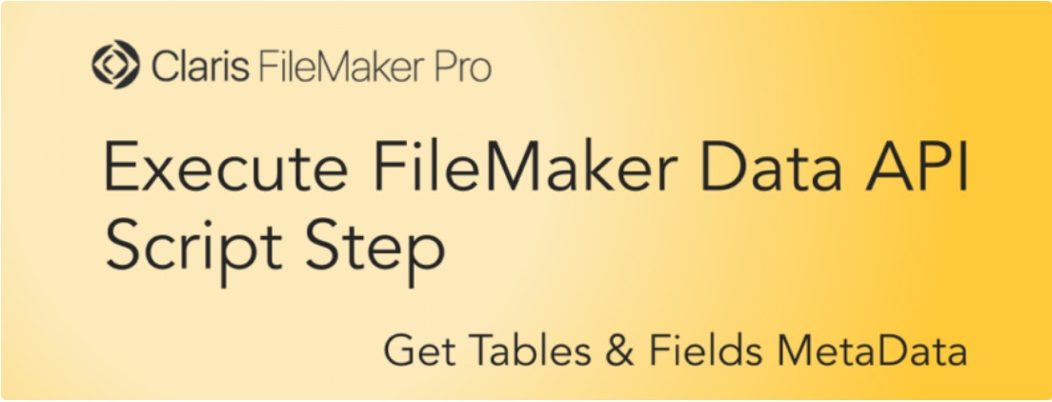
Execute FileMaker Data API
FileMaker 19 Execute FileMaker Data API Script Step
Jeremy Brown, Geist Interactive
SEE Claris KB for more on FileMaker Data and Admin API

Slide 28
Execute FileMaker Data API Demo

Slide 29
How far are you
on the way to mastery?
Muster
Mäster
Mister
Moister
Moster
Master
= eyes open, mustering, "I must!"
= one who feeds / makes fat (German 'animal keeper')
= makes code with errors (German ‘Mist bauen’ = make 💩)
= hacks unstructured code together, works but is non-DRY
= knows most things / nearly there
= a true master of the arts

Slide 30
Questions?

Slide 31
Thank you
Mister Watson (💩)

